Slide 1
Mantid Stakeholder Review
Nick Draper
01/11/2007

Slide 2
Agenda
Introduction
Aim of the Steering Committee
Current state of Mantid
Identification and prioritisation of tasks for the next month

Slide 3
Why do we need Mantid?
Previously different tools were used on the different beamlines.
  PC Collette, Ariel, SXD2000, OpenGenie, LibISIS.
  Confusing for users.
  Replicated effort across the tools.
  Difficult to support.
Mantid
  To standardise data reduction tools between instruments.
  To improve the support and documentation for the tools.
  To handle the expansion of data volume.
  While having the flexibility to be extended by scientists as required.

Slide 4
What will Mantid do?
Mantid
  Manipulation and Analysis Toolkit for ISIS Data
Aims
  To provide a framework for Data Analysis that is not instrument or technique/dependent.
  To support multiple target platforms (Windows, Linux).
  The framework must be easily extensible by Instruments Scientists/Users.
  The framework must be freely redistributable to visiting scientists.
  The framework should provide low-level functionalities for Scripting, Visualization, Data transformation, Implementing Algorithms, Virtual Instrument Geometry.

Slide 5
What will Mantid do?
Scope
  Data reduction and analysis, not Instrument Control.
  Creation of an extensible framework.
  Creation of a command line and scripting interface.
  Creation of a Visualization tool.
  Creation of a repeatable automated test environment.
  Provision of user and support documentation.
  Providing user support for usage and extension of the framework.
  Creation of specific beamline interfaces as required. (Later)

Slide 6
Top Requirements
Easily extensible.
  Support all current and future analysis.
  Support current and future file formats.
  Provide a simple but powerful objects and services to support user created algorithm code.
No user license costs.
Supportable.
Portable.
  Operating System (Windows, Linux).
  Computing Power (Laptop, Server).

Slide 7
Architectural Design - Overview
Instrument log files
Command line & Scripting interface
Mantid Framework
RAW data files
API
Standard Algorithms
User Defined Algorithms
QTIPlot Graphing tool
NEXUS data files
Matlab Interface
Future Data analysis GUI

Slide 8
Development Process
Iterative development – Why?
  Adaptability - the ability to rapidly respond to changes in strategy, priorities, and plans
  Value - continuous delivery of more useful functionality
  Visibility - stakeholder collaboration and validation throughout the development life-cycle
  Risk - the reduction in overall project risk as a result of #1-3 above

Slide 9
Development Process
Iterative development.
  Top level aim defined.
  Tasks identified and allocated to fulfill the aim.
  4 weeks of development and testing.
  Automated tests built alongside all functionality.
  Review, and plan the next iteration.

Slide 10
Software led by Scientists
This is project is intended to support the needs of all of the beamlines.
We need input from each group of instruments
  To ensure what we build fits what you need.
  To ensure good communication between the Mantid project and the scientists.
  To allow each group to have equal input into the project.

Slide 11
Scientific Steering Committee
Who are we
  The Mantid project manager and a representative from each group of instruments.
What are we here to do
  Raise new enhancement requests and report issues.
  Prioritise the list of tasks to be done over the next iterations.
  Review the progress of each iteration.

Slide 12
What Mantid can do now
Data Input
  Raw files and associated log files
  Instrument definition files (Mantid XML format)
  Nexus files (limited support – data only)
Data Export
  Simple comma separated value format
  Nexus files (limited support – data only)
Internal Data Structures
  1D and 2D workspaces
  Managed 2D workspaces for large volumes of data

Slide 13
What Mantid can do now
Algorithms
  Simple binary mathematical operations
    +, -, *, /
  Integration
  Rebin
  ConvertUnits
    TOF, λ, energy, d-Spacing, q, Q², Energy transfer (meV and 1/cm)
  Grouping of detectors
  Marking detectors as dead
Instrument Definition
  Sufficient definition to allow conversion of units
  Loading instrument definition from XML files
  Loading instrument definition from RAW files

Slide 14
What Mantid cannot do yet a highly incomplete list
Data Input
  Nexus files (instrument + sample definition)
  Real time extraction from DAE
Data Export
  Nexus files (instrument + sample definition)
Internal Data Structures
  Workspaces capable of holding data in Q
  Flexible workspaces (having 2 user definable axes)

Slide 15
What Mantid cannot do yet a highly incomplete list
Algorithms
  Full validation rules for binary mathematical operations
  Collection duration is not taken into account
  Support for non Gaussian Errors
  Peak searching
  Peak integration
  Conversion to Q
Instrument Definition
  Sufficient definition to allow Monte Carlo simulations
  Sufficient definition to allow 3D visualization

Slide 16
User Interfaces
Early Prototypes
  QTIPlot-Mantid
    A graphical plotting tool which interfaces directly to Mantid for data interaction and analysis.
  Python
    Command line access and scripting
Proof of concept
  Matlab Interface

Slide 17
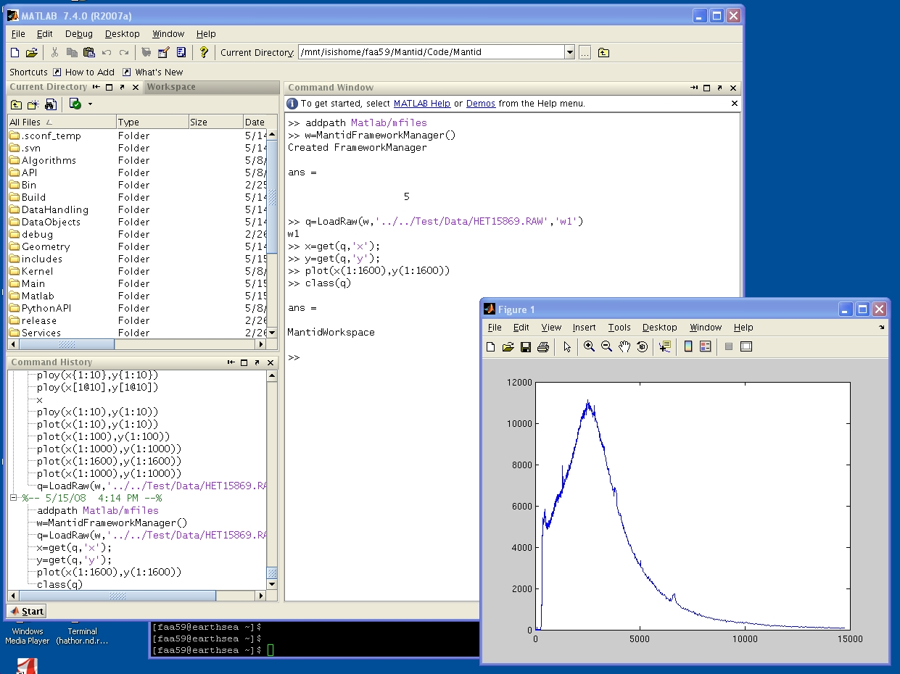
Matlab Interface

Slide 18
Deciding priorities for Mantid
Decide the key things Mantid needs to do for your instruments.
Consider each one and pick the first tasks that need to be done to achieve the goals.
Prioritise the individual tasks.

Slide 19
Further Information
Project Web Page
  www.mantidproject.org
Project Introduction Document
  http://svn.mantidproject.org/mantid/trunk/Documents/Requirements/Project%20Introduction%20Document.doc
User Requirements Document
  http://svn.mantidproject.org/mantid/trunk/Documents/Requirements/URD.doc
Architectural Design Document
  http://svn.mantidproject.org/mantid/trunk/Documents/Design/Architecture%20Design%20Document.doc

